Slide 1
Part 1& 2.
Student Health & Human Services
Office of Human Relations, Diversity & Equity
June 2022

Slide 2
Welcome Would you rather read the book or watch the movie?
Book
Movie
Notes:
Invite the students to participate in the warm up question.

Slide 3
Objectives
Learn about
Indigenous Peoples' Day.
Discuss
the significance of Indigenous Peoples' Day.
Reflect on
Changing Columbus Day to Indigenous People’s Day
Notes:
Read the slide aloud for the students.

Slide 4
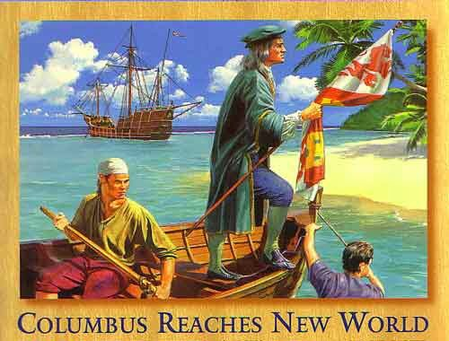
In 1492...
Columbus sailed the ocean blue…
and discovered America...
Or did he?
Let’s learn about the history of Columbus Day
Notes:
Read the slide aloud for the students.

Slide 5
The real story of Columbus Day
Notes:
Play the video for the students. (5:45)
https://www.youtube.com/watch?v=hSum6Xe64C4

Slide 6
REFLECTION
What did you learn about the history of Columbus Day?
Why did the Italians rally to establish Columbus Day?
Do you think we continue celebrating Columbus Day?
Notes:
Invite the students to egnage in reflection.

Slide 7
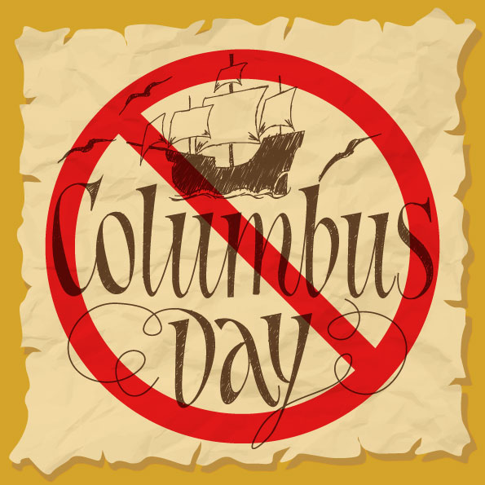
Who Recognizes Columbus Day?
Columbus Day is still a federal holiday. Meaning it is observed by banks, the bond market, the U.S. Postal Service, other federal agencies, most state government offices, many businesses, and most school districts.
However, states and local governments can choose not to observe a federal holiday.
In 2014 LAUSD stopped school closures on Columbus Day in favor of closing on Cesar Chavez Day!*
Los Angeles County has recognized Indigenous Peoples' Day rather than Columbus Day since 2018.
Notes:
Read the slide aloud for the students. Emphasize the fact that LAUSD stopped school closures on Columbus Day in 2014, 4 years before the city adopted Indigenous Peoples' Day.
Fun Fact: we will have a Push & Play available for Caesar Cavez day as well.

Slide 8
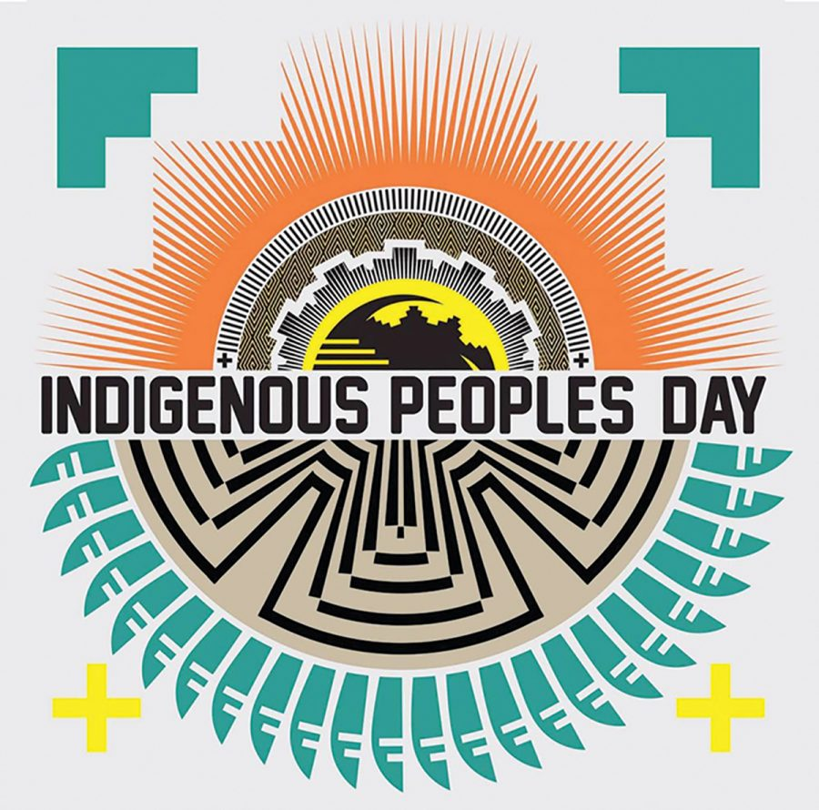
What is Indigenous Peoples' Day?
Indigenous Peoples' Day celebrates and honors Native American peoples and their histories and cultures.
Indigenous Peoples' Day is celebrated across the US on the second Monday in October.
Indigenous Peoples' Day began as a counter-celebration held on the same day Columbus Day.
Notes:
Read the slide aloud for the students.

Slide 9
BREAK
Time permitting, this would be a great spot to stop, and pick back up in your next session!
Notes:
Teacher: if you do not have enough time to finish this lesson today, stop here and pick back up in your next session.

Slide 10
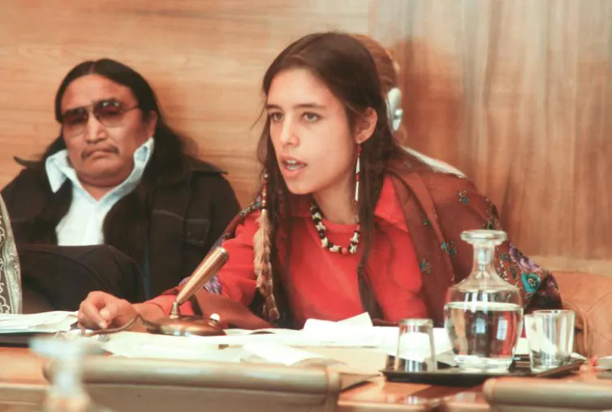
History of Indigenous Peoples' Day
In 1977 the International Conference on Discrimination Against Indigenous Populations in the Americas was sponsored by the United Nations.
This conference initiated the discussion of replacing Columbus Day with Indigenous Peoples' Day.
Notes:
Leading activist Winona LaDuke addressing the 1977 conference. (pictured)
Read the slide aloud for the students.

Slide 11
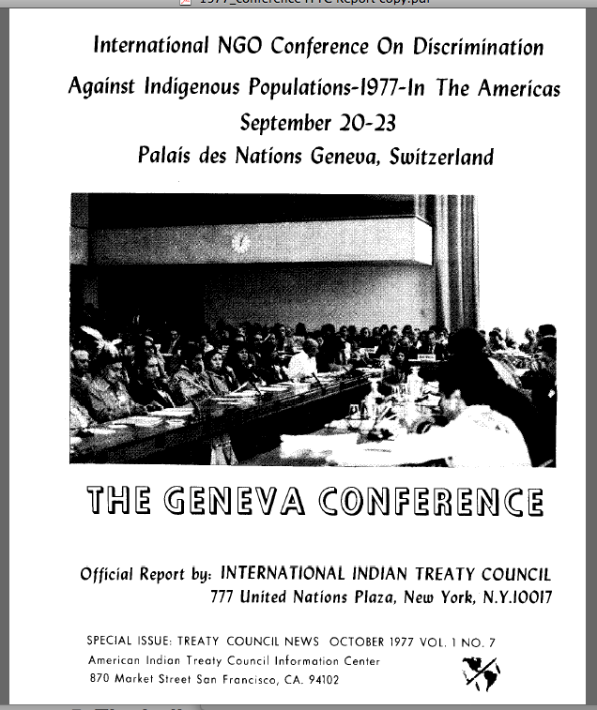
Wait a minute...
Let's break this down really quick:
International Conference: Held, organized, attended, and powered by leaders around the WORLD!
Discrimination Against Indigenous Populations in the Americas: focused specifically on the mistreatment (read: genocide) of Indigenous Populations ONLY IN the Americas.
This is a remarkable occurrence.
This is the GLOBAL community coming together to acknowledge an issue in the American continents.

Slide 12
REFLECTION
Why do you think the global community convened to address the Indigenous Peoples' challenges in the Americas?
Notes:
Read the slide aloud for the students and invite the students to reflect. If necessary, explain to the students that it is significant that world leaders sought to engage with Indigineous Peoples of Americas due the historic, systematic oppression of Indigenous Peoples by the Americas.

Slide 13
International Conference on Discrimination Against Indigenous Populations in the Americas
The conference included the UN’s major agencies, 33 national governments, 38 international organizations, and indigenous delegates from 14 countries in the Americas.
At the forefront were representatives of the Lakota Nation, a Sioux people concentrated in the Dakotas.
Notes:
Read the slide aloud for the students.

Slide 14
International Conference on Discrimination Against Indigenous Populations in the Americas
The United Nations agreed to develop a supranational monitoring and advisory program to help protect the human rights of Indigenous People.
This program is aimed at addressing systemic discrimination against Native Americans that continues to this day
AND – initiated the discussion of replacing Columbus Day with Indigenous Peoples' Day.
Notes:
Read the slide aloud for the students.

Slide 15
Indigenous Peoples Day Celebration
Notes:
Play the video for the students. 2:28
Sunrise Ceremony on Alcatraz Celebrating Indigenous Peoples Day - YouTube

Slide 16
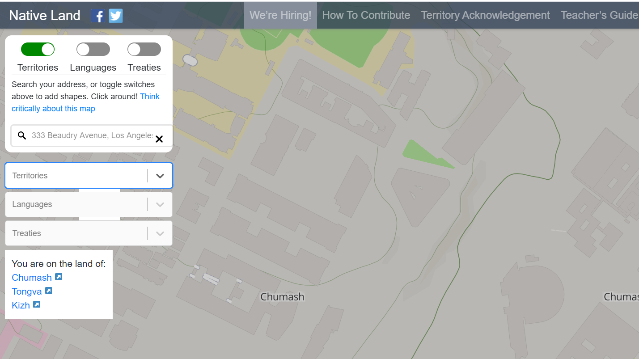
How can YOU honor Indigenous Peoples' Day?
Learn about the history of the people whose land you live on!
Type your address into "native-land.ca"
As you can see here, LAUSD District HQ (Beaudry) is on Chumash, Tongva and Kizh land.
Notes:
Invite the students to egnage in an activity wherein they discover whose land your school location is on. Invite the students to click the links to learn more about each of the different groups.

Slide 17
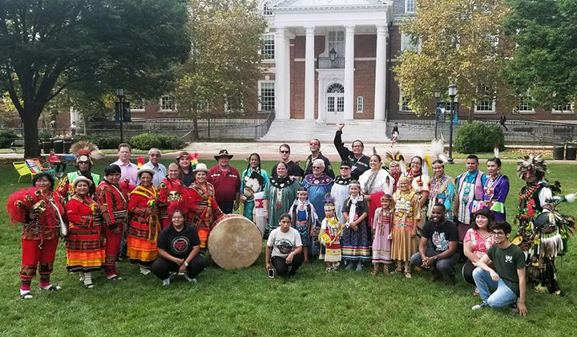
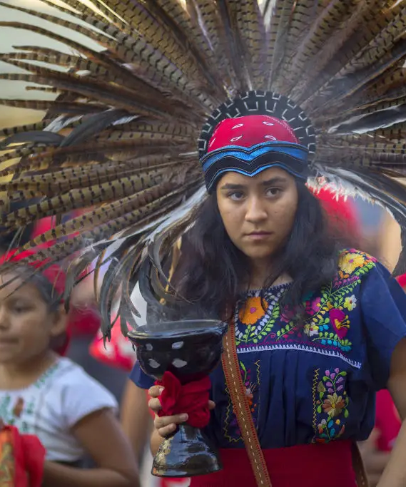
Honoring Indigenous Peoples' Day
Once you have discovered whose land you are on, click on the link and learn more about those nations.
One of the best way we can honor other cultures is by learning more about them!
Notes:
Read the slide aloud for the students.

Slide 18
Check Out Would you rather have soup or a sandwich?
Soup
Sandwich
Notes:
Invite the students to engage in the check-out

Slide 19
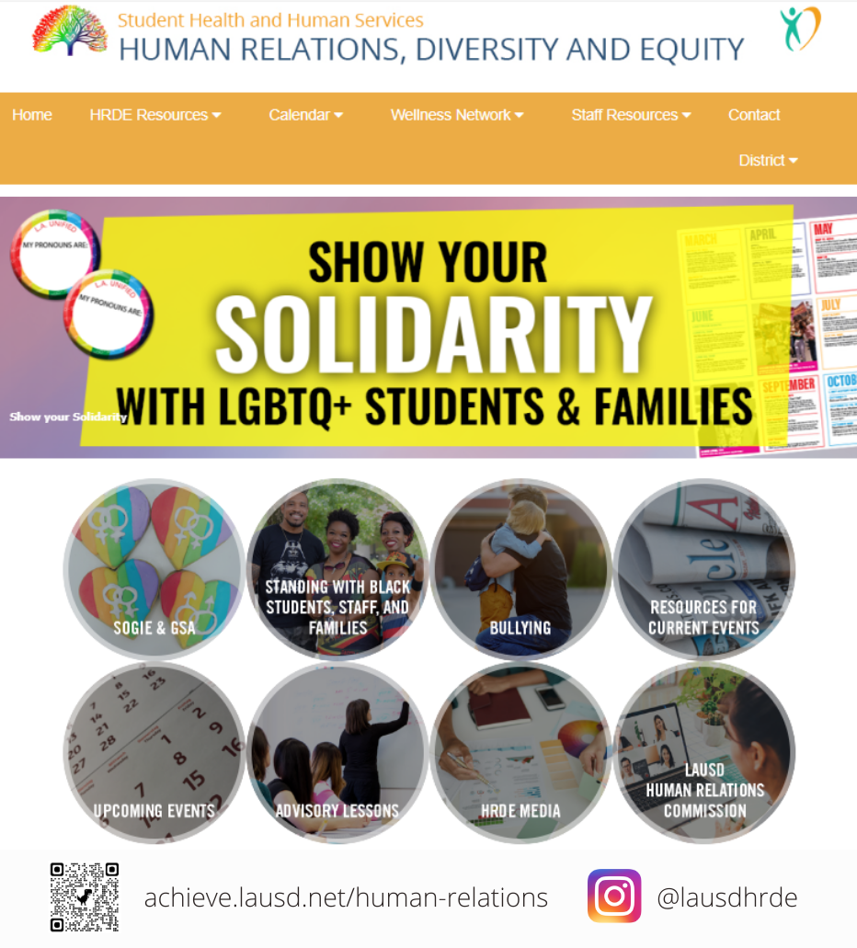
Human Relations Diversity & Equity

Slide 20
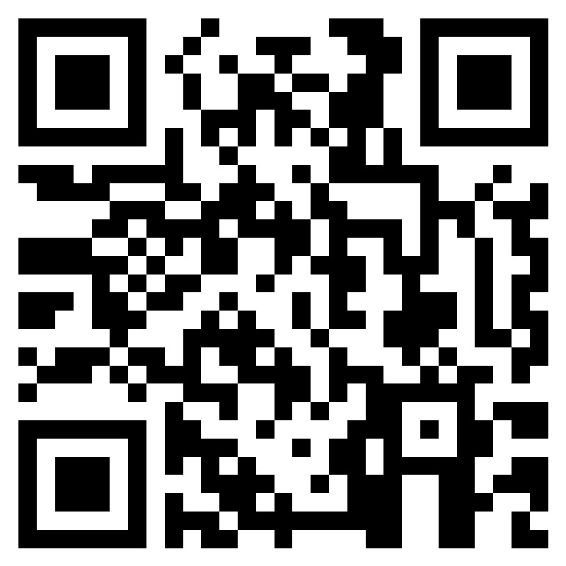
Teacher Feedback Form
Notes:
Teacher, please scan the QR code or click the link below to complete a brief feedback survey:
https://forms.office.com/r/i9UqyyxzTT

